Slide 1
Wednesday, January 19
Pick up “Specialization, Trade and Advantage” Activity from my desk at the front of the room.
You will need something to write with for today’s activity.
Please get out your 17.1 Activity – we are going to grade this!
Absent yesterday? See Mrs. Powell to schedule your make-up test and check the Tuesday folder for your missed assignment.
Current Events
Comparative Advantage/Circular Flow Quiz is next Tuesday…

Slide 2
Wednesday, January 19
Pick up a “Political Spectrum Survey” from my desk at the front of the room.
ON YOUR OWN PAPER – answer the questions to the best of your ability! This is designed to help you sort out your thoughts on politics and the role government.
Current Events
Get out your notes!
HW: Print the Part II Guided Reading – due on Friday!

Slide 3
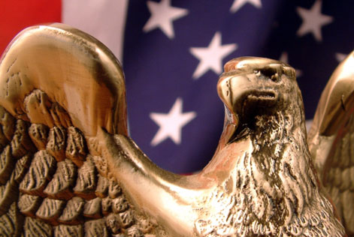
“Who Can Vote?”

Slide 4
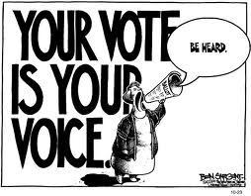
The Importance of Voting
Voting is a major civic responsibility.
Voting allows citizens to :
  To be a part of the electorate
  Choose their government leaders
  Voice their opinions on past performances of public officials
  Express their opinion on public issues
Click picture for clip!

Slide 5
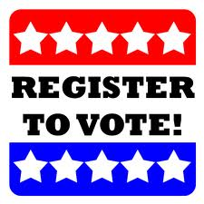
Voter Registration
The power to set voting qualifications is reserved for the States. There are limitations to those powers:
  Can’t be denied the right to vote in national elections
  Can’t be denied on “account of race, religion, color or previous condition servitude” (15th Amendment)
  Can’t be denied on account of sex (19th Amendment)
  No payment for the right to cast your vote (24th Amendment)
  Can’t be denied if you’re over 18 (26th Amendment)
You must register to vote before you can take part in an election in most states.
  Exception: North Dakota
Registration applications may vary from state to state

Slide 6
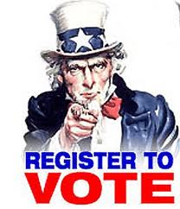
Voter Registration
In order to register in the state of Florida you must:
  Be a citizen of the United States
  Be a legal resident of both the state of Florida and of the county in which you are registering
  Be 18 years old (you may pre-register if you are 17)
  Be mentally capable of making decisions
  Not have been convicted of a felony (unless the governor has restored your rights)
  Register at least 29 days before the election takes place

Slide 7
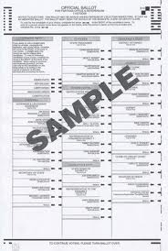
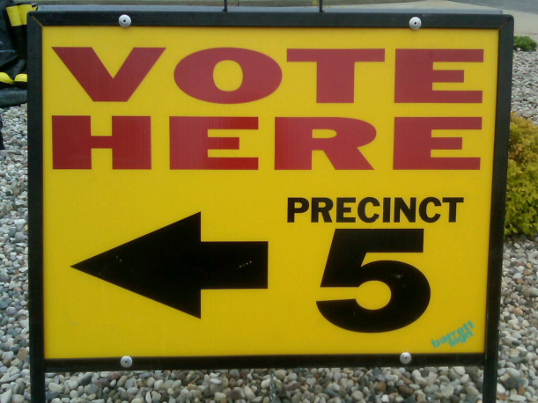
Steps in Voting
On Election Day, voters go to the polling place in their precinct, or voting district.
When you arrive you will go through a series of checks to confirm your identity, and confirm you are registered to vote.
Next you will receive a ballot, or list candidates on which you cast your vote.

Slide 8
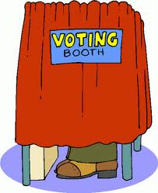
Steps in Voting
You will then go to the voting booth to cast your vote.
After the polls are closed, elections workers send the ballots and the results – called returns – to the election board.
The board then sends the returns to the state canvassing authority who then certifies the election of the winner.

Slide 9
“Elections”

Slide 10
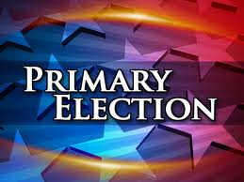
Primary Elections
Primary elections occur first and help narrow the field of candidates for each Political Party.
Open Primary – an election in which voters need not declare their party preference
Closed Primary – only declared members of a party are allowed to vote for that party’s nominees. We have this in Florida!!!

Slide 11
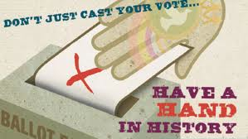

General Elections
General Election – voters choose leaders for various offices such as president (kind of….), Congress members, and state and local positions.
  General elections always take place on the first Tuesday after the first Monday in November.
  Presidential elections occur every four years in even numbered years. (The next presidential election will be in 2016.)
  In all races except the Presidential race, the candidate who wins the majority of the popular vote is elected into the office.

Slide 12


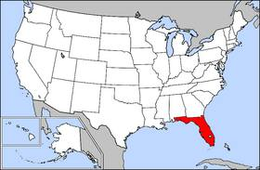
Elections
Elections are held at three levels: federal, state and local.
** States oversee their own elections!

Slide 13
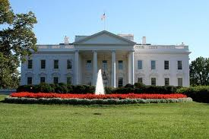
Presidential Election

Slide 14

Campaign
Campaign – the process in which candidates are competing for public office using media, debates, and speeches.
  Candidates travel to different states to give speeches, meet with state and local leaders and face their opponents in debates.

Slide 15
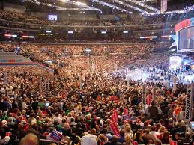
Nomination
Nomination - the process in which political parties select and offer candidates for public office
  Presidential hopefuls start campaigning a year or more before the election.
  So much campaigning goes on during the primary elections that the conventions are now used to “kick off” the campaign and rally party members.

Slide 16
The Electoral College
  There was much debate over who should select the President when the Constitution was being written ---- The compromise was to have the Legislatures in each state choose a slate of Presidential Electors who would then pick the president.
  Today, voters have a bigger say than we did in the beginning. We vote on election day and our vote tells the electors “how we want them to vote”…
  The Electoral College is a “Winner Take All” System.

Slide 17
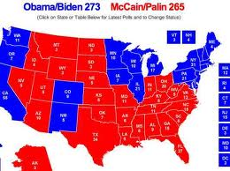
The Electoral College
The Electoral College - the process by which a Presidential candidate is elected to office.
Presidents are not chosen by direct popular vote, but by the Electoral College.

Slide 18
The Vote and Electoral College
  The people vote for the candidate that they would like to see win the Presidency. But the President is not chosen directly by the people…
  The President is actually chosen by the number of electoral votes he/she earns.
  Every state has one elector per U.S. Senator and Representative in that state.
  PLUS Washington, D.C. gets three electoral votes
  There is a total of 538 Electoral Votes in the US (435 + 100 + 3 DC = 538)

Slide 19
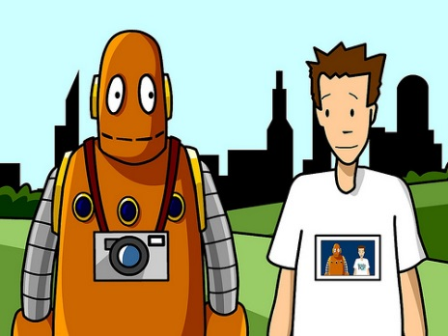
The Vote and Electoral College
The number of electors per state = the number of Senators + the number of Representatives for that state. (Florida currently has 29 electors - 27 House Members + 2 Senators)
The fewest number of Electors a State can have is 3 – Why???
The candidate who receives the majority of the electoral votes wins the election (270 or more of the 538 electoral votes). 435 House Members + 100 Senators + DC = 538

Slide 20
Winner Take All System
The Candidate who wins the most “popular votes” in a state most often wins ALL of the Electoral Votes for that state. (all states except for Nebraska and Maine)…..This is what allows a candidate to lose the Popular Vote yet still win the Presidency. This is rare, but has happened.

Slide 21
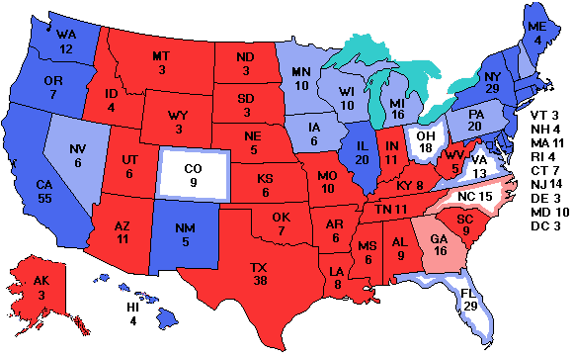
The Electoral College Map Today

Slide 22
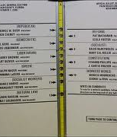
Bush v. Gore - 2000
Your vote does count! But it doesn’t always mean the “people decide”
In the 2000 election Al Gore had 500,000 more votes than George Bush but still lost.
George Bush had more Electoral Votes - 271-266. George Bush won and became the 43rd President.
Al Gore wanted to do a hand recount, but the Courts ruled that using different standards for counting votes in different counties violated the Constitution.

